Slide 1
Car Sales Analysis Summary
Dashboard Overview by Om Panchal

Slide 2
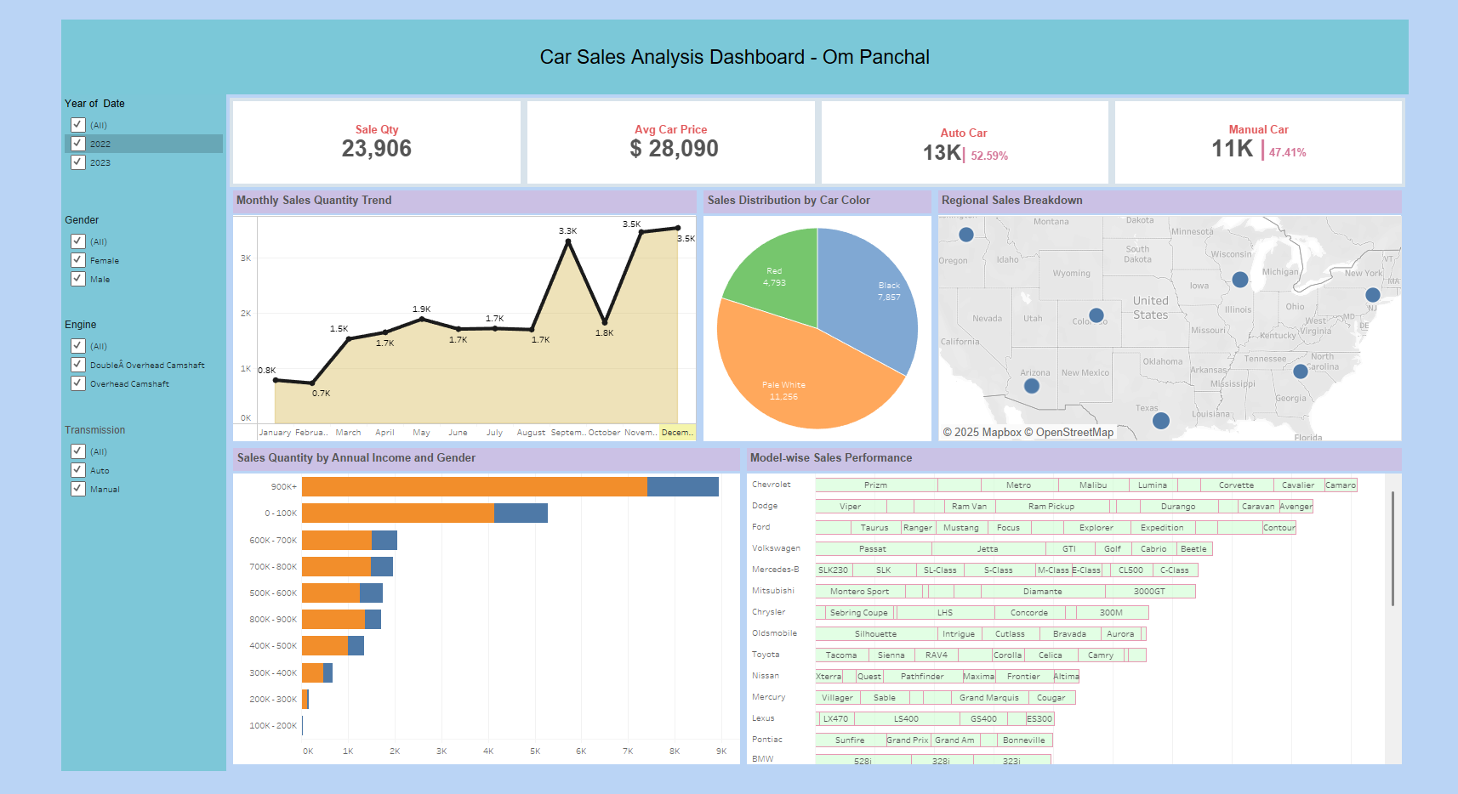
Dashboard Snapshot

Slide 3
Key Insights
- Total Sales Quantity: 23,906 units
- Average Car Price: $28,090
- Auto Transmission: 52.59% | Manual: 47.41%
- Most Popular Color: Pale White (11,256 units)
- Peak Sales Months: October & December (3.5K units each)
- Highest Sales Region: Eastern & Midwestern US States
- Dominant Buyer Income: 0-100K and 900K+ segments

Slide 4
Monthly Sales Trend
- Sales increased significantly in October and December (3.5K units).
- February saw the lowest sales (~0.7K units).
- Consistent performance from April to August (~1.7K units average).

Slide 5
Sales by Car Color
- Pale White is the most preferred color (11,256 units).
- Black follows with 7,857 units sold.
- Red has the lowest share among the three (4,793 units).

Slide 6
Sales by Income & Gender
- Highest purchases from the income bracket 0-100K and 900K+.
- Gender distribution relatively even across most income groups.
- Lower income groups (100K–200K) contributed the least to sales.

Slide 7
Model-wise Sales Performance
- Diverse range of models sold from brands like Toyota, Ford, Chevrolet.
- High model variation from Ford, Toyota, and Nissan.
- Indicates a wide customer preference across categories and segments.

